Slide 1
DEEP LEARNING • MLA0408 • CO5-AT3 TECHNICAL PRESENTATION
Undercomplete and Regularized Autoencoders
How autoencoders compress data through a bottleneck — and learn to reconstruct it again
Input
Latent code
Output
Name: Haresh Kumar N L Register No: 192425009

Slide 2









INTRODUCTION
What Is an Autoencoder?
An autoencoder is a neural network trained to learn a compact, efficient representation of its input data — then reconstruct that input from the compressed code.
Encoder
Converts the raw input into a compact latent representation.
Decoder
Its objective is simple: make the reconstructed output as close as possible to the original input.
Reconstructs the original input back from that latent representation.
MLA0408 • CO5 — Autoencoder Variants 2 / 10

Slide 3



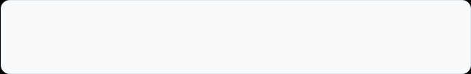

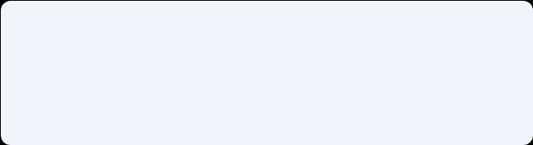



ARCHITECTURE
How an Autoencoder Works
ENCODING
DECODING
•
x — the original input
•
z — the latent representation
•
x̂ — the reconstructed input
The encoder compresses the information; the decoder attempts to recover the original data.
MLA0408 • CO5 — Autoencoder Variants 3 / 10

Slide 4
UNDERCOMPLETE AUTOENCODERS
Learning Through a Bottleneck
An undercomplete autoencoder has a latent representation with fewer dimensions than the input — forcing the network to learn only the most important underlying features.
Encoder
Decoder
100 Input Features 10 Latent Features 100 Reconstructed Features
Latent dimension < Input dimension
Forces the model to learn important features
Prevents simply copying the input
Useful for dimensionality reduction
MLA0408 • CO5 — Autoencoder Variants 4 / 10

Slide 5









UNDERCOMPLETE AUTOENCODERS
From Input to Reconstruction
Encoding
Latent Representation
Decoding
The encoder transforms high-dimensional input into a smaller latent vector.
Holds the compressed, important information — redundant or unnecessary detail is removed.
The decoder reconstructs the original input from that compressed latent vector.
MLA0408 • CO5 — Autoencoder Variants 5 / 10

Slide 6
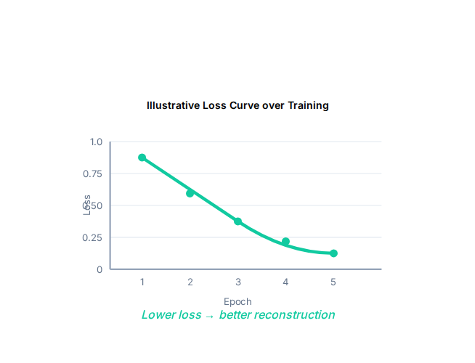




TRAINING OBJECTIVE
Measuring Reconstruction Loss
The autoencoder learns by minimizing the difference between its original input and the reconstructed output.
Minimize Reconstruction Loss
MEAN SQUARED ERROR (MSE)
•
xi — the original value
•
x̂i — the reconstructed value
•
n — the number of features
MLA0408 • CO5 — Autoencoder Variants 6 / 10

Slide 7





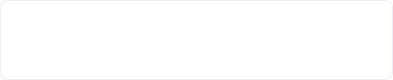


ADVANCED CONCEPTS
Regularized Autoencoders
Why Regularization?
COMMON APPROACHES
A powerful autoencoder could simply learn an identity function, essentially memorizing the data:
Sparse Autoencoder
Encourages only a small number of neurons to be active.
Denoising Autoencoder
Learns to reconstruct clean data from corrupted input.
Regularization encourages the model to learn meaningful and useful features instead of just copying data.
Contractive Autoencoder
Encourages representations that are less sensitive to small input changes.
MAIN PURPOSE
Prevent unwanted learning → Improve feature representation → Increase robustness
MLA0408 • CO5 — Autoencoder Variants 7 / 10

Slide 8

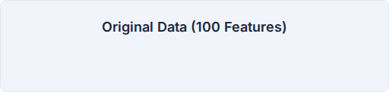





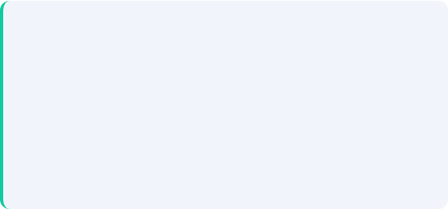

PRACTICAL USES
Dimensionality & Feature Learning
Feature Learning
Dimensionality Reduction
The model automatically learns important patterns such as:
Applications
•
Image compression
•
Data visualization
•
Feature extraction
•
Anomaly detection
MLA0408 • CO5 — Autoencoder Variants 8 / 10
The 10-dimensional representation can be used instead of the original 100 features.

Slide 9
COMPARISON
Undercomplete vs Regularized
Feature | Undercomplete Autoencoder | Regularized Autoencoder
Main idea | Smaller latent space | Adds constraints/penalties
Latent representation | Smaller than input | Can vary (sometimes larger)
Main purpose | Compression & feature learning | Robust & meaningful features
Prevents trivial copying | Through physical bottleneck | Through mathematical regularization
Example | 100 → 10 features | Denoising / Sparse / Contractive
Applications | Dimensionality reduction | Noise removal, robust learning
MLA0408 • CO5 — Autoencoder Variants 9 / 10

Slide 10
SUMMARY
Conclusion
•
Efficient Representations: Autoencoders learn efficient representations of input data through unsupervised learning.
•
Dimensionality Reduction: Undercomplete Autoencoders use a strictly smaller latent space to force compression and dimensionality reduction.
•
Robust Features: Regularized Autoencoders introduce constraints (like sparsity or noise injection) to encourage meaningful and robust feature learning without requiring a strict bottleneck.
•
Training Objective: Reconstruction loss measures how accurately the input is reproduced, guiding the network's learning process.
•
Versatility: Both approaches are highly useful for feature extraction, dimensionality reduction, compression, and anomaly detection.
MLA0408 • CO5 — Autoencoder Variants 10 / 10

